Slide 1
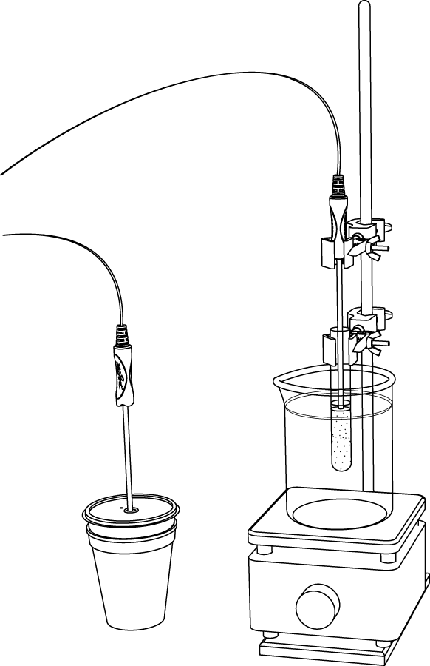
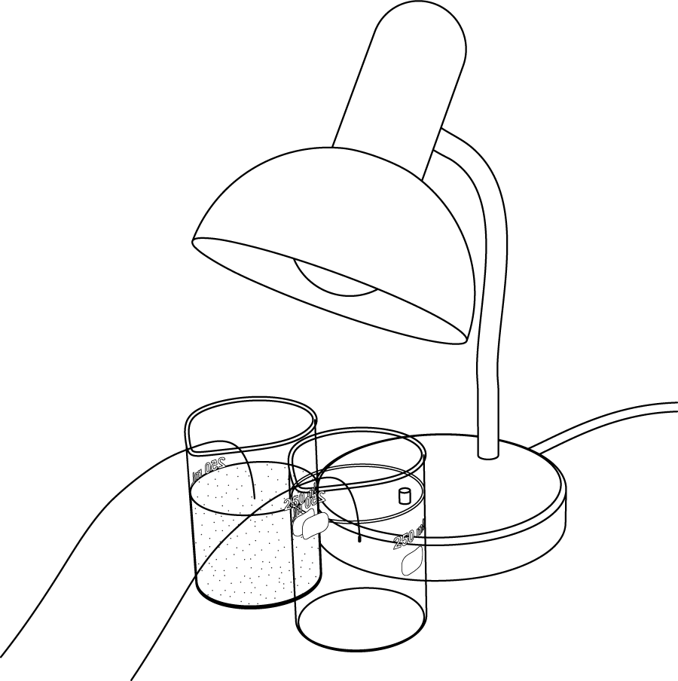
Temperature sensor
Fast-response
temperature probes
Sand
Calorimeter
Sand
Water

